Slide 1
Background:
It seems obvious that the themes / environment we’re exposed to as children would heavily influence how we see and deal with the world as adults. More specifically, I want to see if it’s possible to see that in some way in politics. For instance, it seems to me that politicians these days are very polarizing and tend to classify things as good/evil, black/white. I wonder if that was a product of growing up in the time when it was the USA vs the USSR? When TV shows portrayed characters as either good or bad (think A Team). On the other hand, TV shows today seem to be exploring the gray in the world. They create characters who are good guys that do some bad things and bad guys that have some redeeming qualities. Comparing the original Battlestar Galactica series to the remake is a good example of this.
I will be using Alchemy API and analyzing different sources over time such as:
TV summaries from thetvdb.com
Political speeches from http://www.americanrhetoric.com/speechbank.htm
I’m hoping to see some correlation in themes offset by a certain number of years.

Slide 2
http addresses of pages with links to speeches
Top Level Flow Chart
thetvdb.com search url
Process XML page source to extract all links.
Use search tool from thetvkb.com. Loop through years 1940 – 2013 and extract show titles
speech_links[http link, …]
tv_shows: [[Show, Date(Year)], [show 2], …]
Follow each link and extract author, year, and text of speech
Get text of TV Show summaries
speeches: [[Author, Date(Year), Text], [speech 2], …]
tv_shows: [[Show, Date(Year), Summary Text], [show 2], …]
Process Speech Text
Process TV Show Summary Text
Extract keywords from political speeches
Extract keywords from TV Show summaries
speeches: [[Author, Date(Year), Text, keywords], [speech 2], …]
tv_shows: [[Show, Date(Year), Summary Text, keywords],
[show 2], …]
Keyword Extraction
Keyword Extraction
Summarize political speech keywords
Summarize tv show keywords
speech_keyword_count: [[keyword, year, count], […], …]
tv_show_keyword_count: [[keyword, year, count], […], …]
Action
Minimize cost function to compute optimal offset across all keywords
output
Data Structure
Correlation Algorithm
Cost function: tv_show_keyword_count(t) – (speech_keyword_count(t-G))
Where t is time and G is the optimal time shift
input
Possible Visualizations: Heat map before and after shift.

Slide 3
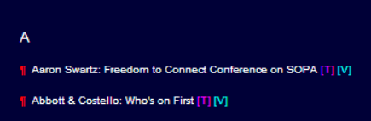
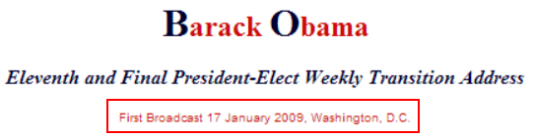
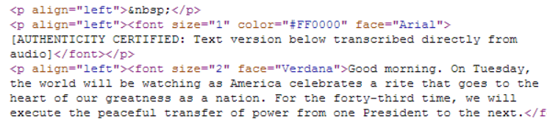
Process Speech Text
Speech Web Crawl
http addresses of pages with links to speeches
Web Site: American Rhetoric
/Speechbank
/Speeches A-F
Speaker: Speech Title
/Speeches G-L
/Speeches M-R
/Speeches S-Z
Process XML page source to extract all links.
speech_links[http link, …]
Follow each link and extract author, year, and text of speech
speeches: [[Author, Date(Year), Text], [speech 2], …]
Link to text on American Rhetoric?
yes
no
Link to speech is always of the form “author:
Save in List:
Author
Date of Speech
Text of Speech
Skip speech
Date always occurs right before text of speech
Text of speech

Slide 4
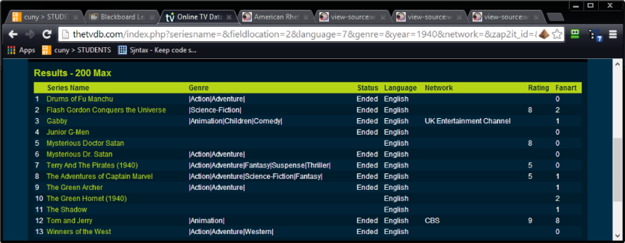
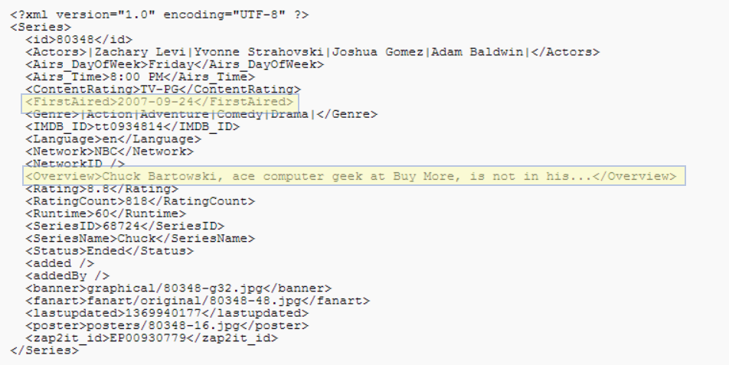
Process TV Show Summary Text
TV Show Summary:
In the IMDB terms of use page, they state:
“Robots and Screen Scraping: You may not use data mining, robots, screen scraping, or similar data gathering and extraction tools on this site, except with our express written consent as noted below.”
I found an alternative that seems to be more forthcoming with their data: thetvdb.com.
thetvdb.com search url
Use search tool from thetvkb.com. Loop through years 1940 – 2013 and extract show titles
http://thetvdb.com/index.php?seriesname=&fieldlocation=2&language=7&genre=&year=1940&network=CBS&zap2it_id=&tvcom_id=&imdb_id=&order=translation&addedBy=&searching=Search&tab=advancedsearch
tv_shows: [[Show, Date(Year)], [show 2], …]
For each show, get text of TV Show summaries
tv_shows: [[Show, Date(Year), Summary Text], [show 2], …]
Web Site: thetvdb.com
Register for API
Use API to access required information
tv_shows: [[Show, Date(Year)], [show 2], …]
Save in List:
Show
Date (Year)
Summary Text

Slide 5
Keyword Extraction
tv_shows: [[Show, Date(Year), Summary Text], [show 2], …]
speeches: [[Author, Date(Year), Text], [speech 2], …]
Loop through each item and process text with Alchemy API
speeches: [[Author, Date(Year), Text, keywords], [speech 2], …]
tv_shows: [[Show, Date(Year), Summary Text], [show 2], …]
For each item.
For each keyword
If keyword exists, add one to count, if keyword does not exist, add it and start count at one.
*_keyword_count: [[keyword, year, count], […], …]

Slide 6
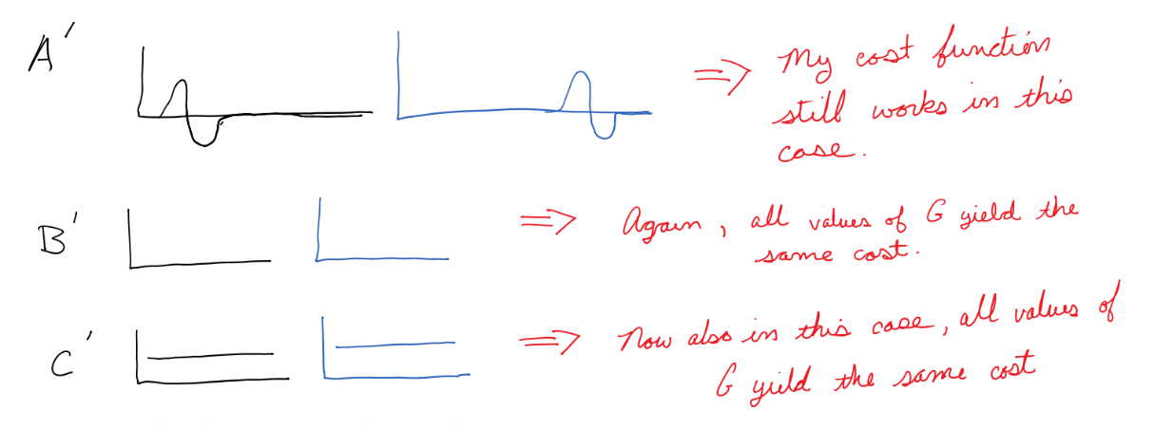
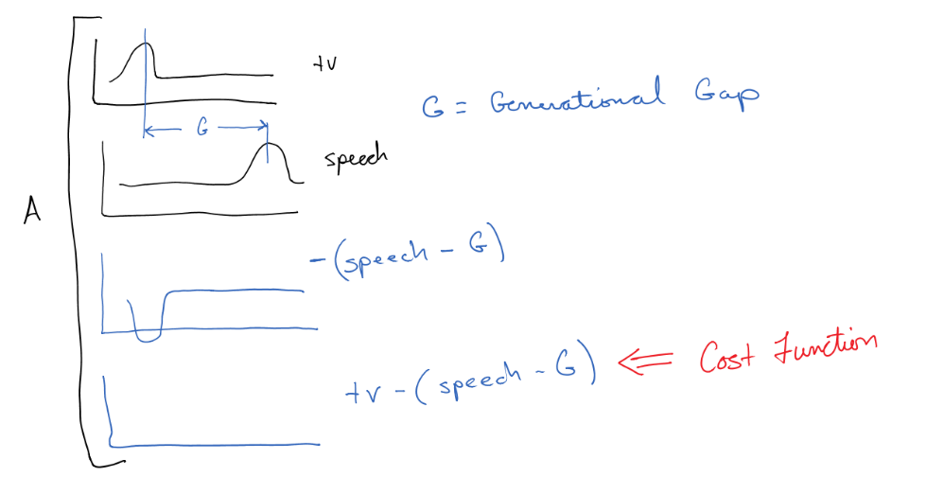
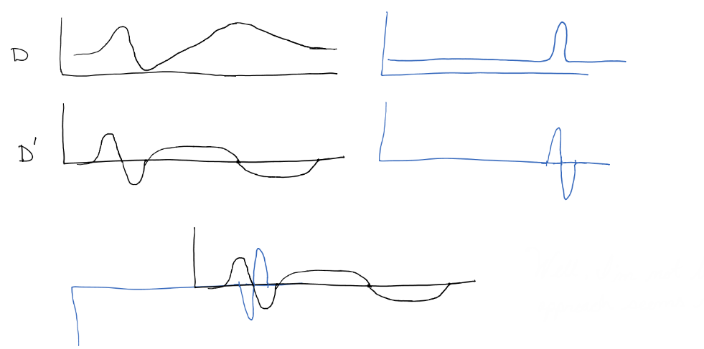
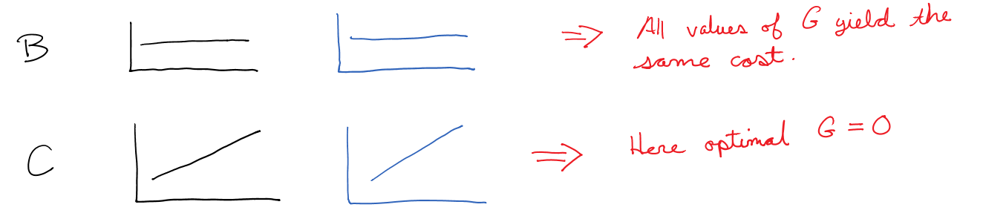
Correlation Algorithm
How do I compare speeches and shows?
What if I take the derivative?
Let’s say I have a perfect correlation. It would look something like this:
So how would this work on a more generic function?
How would that work with other shapes?
Not good
Cost function
Seems reasonable
In summary, my plan is to fit a function to each keyword data F_{tv}(t) and F_{speech}(t), then to calculate G such that across all keywords F’_{tv}(t) - (F’_{speech}(t) – G) is minimized. Along with this I hope to create a plot of some kind to see the result visually. Note: I think this works from a conceptual standpoint, but I’m afraid that implementing this may prove challenging. As a fall back, I think I can create a visualization plot that can be used to determine if there appears to be a correlation and build on this in the future.

